Slide 1

DEPARTMENT OF COMPUTER SCIENCE & ENGINEERING
SCHOOL OF COMPUTING
1156CS601- MINOR PROJECT
SUMMER SEMESTER(21-22)
REVIEW - II
“Speech Emotion Recognition Using MLP Classifier in Machine Learning”
SUPERVISED BY
Dr. C CHANDRU VIGNESH
Assistant professor
PRESENTED BY
1. Sujit Yadav (16240)(19UECS0937)
2. Santosh Mehata (16195)(19UECS0873)
3. Shyam Kumar Sah (16200)(19UECS0909)

Slide 2
AGENDA
ABSTRACT
OBJECTIVE
INTRODUCTION
LITERATURE REVIEW
DESIGN AND METHODOLOGIES
IMPLEMENTATION
TESTING
INPUT AND OUTPUT
CONCLUSION
REFERENCES
WEB REFERENCES
PLAGIARISM REPORT (should be less than 15%)

Slide 3
ABSTRACT
Speech Emotion Recognition, abbreviated as SER, is the act of attempting to recognize human emotion and the associated affective states from speech. Emotion recognition is a rapidly growing research domain in recent years. Human-computer interaction can be improved by implementing automated emotion recognition, thereby reducing the need of human intervention. In this project, basic emotions like calm, happy, fearful, disgust etc. are analyzed from emotional speech signals. We use machine learning techniques like Multilayer perceptron Classifier (MLP Classifier) which is used to categorize the given data. For achieving this objective, we use python libraries like Librosa, sklearn, pyaudio, numpy and soundfile to analyze the speech modulations and recognize the emotion.

Slide 4
OBJECTIVES
Aim of the Project:
The audio files are given as the input. The data sets travels through a number of blocks of processes which makes it executable to help for the analysis of the speech parameters. The data is preprocessed to change it to the suitable format and the respective features from the audio files are extracted using various steps such as framing, hamming, windowing, etc.
Scope of the Project
To enter the unknown test dataset as an input, it will retrieve the parameters and predict the emotion as per training dataset values. The accuracy of the system is displayed in the form of percentage which is the final result of our project.

Slide 5
INTRODUCTION
speech emotion recognition (SER) is becoming increasingly important in various applications.
At present, speech emotion recognition is an emerging crossing field of artificial intelligence and artificial psychology.
The research is widely applied in human-computer interaction, interactive teaching, entertainment, security fields, and so on.
Speech emotion processing and recognition system is generally composed of three parts, the first being speech signal acquisition, then comes the feature extraction followed by emotion recognition.
The most propitious technique for speech recognition is the neural network based approach. Artificial Neural Networks.
Speech recognition is the process of converting an acoustic signal, captured by microphone or a telephone, to a set of characters.

Slide 6
LITERATURE REVIEW
S.No | Author Name | Year | Journal Name | Methodologies | Advantages / Disadvantages
1 | Jerry Joy, Aparna Kannan, Shreya Ram, S. Rama | 2020 | Speech Emotion Recognition using Neural Network and MLP Classifier | In this paper the emotions in the speech are predicted using neural network. Multi-Layer Perceptron Classifier (MLP Classifier) is used for the classification of emotions | Positive (85.01%) emotion recognition rate is higher than other approaches but neutral(25.76%) and negative(10.24%)emotions are often confused with each other
2 | J.A. Dominguez-Jimenez, K.C. Campo-Landines | 2020 | Biomedical signal Processing and control | one class in one neural network | Achieved mean recognition rate of 90% It is complex process

Slide 7
Cont.,
S.No | Author Name | Year | Journal Name | Methodologies | Advantages / Disadvantages
3 | Chaitanya Singlaa, Sukhdev Singhb,Monika Pathak | 2020 | Automatic Audio Based Emotion Recognition System: Scope and Challenges | Common sense Affect based approach (Real world Knowledge concept models) | The system obtained the accuracy of around 72% for various audio extracted from the various voice sample.
4 | Navya Damodar, Vani H Y, Anusuya M A | 2019 | InternationalJournal of Innovative Technology and Exploring Engineering | Voice Emotion Recognition using CNN and Decision Tree | This model can be improved by making the dataset times three times the original size to achieve a greater accuracy.

Slide 8
DESIGN AND METHOLOGIES
MODULE 1:
Feature abstraction module training.
MODULE 2:
To give trained dataset to MLP Classifier
MODULE 3:
To test the unknown audio dataset as input

Slide 9
MODULE:1 Feature abstraction module training
The input to the model should be the features extracted along with the emotion category that it belongs to, stored correspondingly into respective arrays so that, classifier will be able to identify the patterns, correlations and then classify the data. This training helps the model to understand, which emotions have what range of the respective features. So, when an unseen data is given as an input, it will be able to correlate and predict the emotion.

Slide 10
MODULE: 2
TO GIVE TRAINED DATASET TO MLP CLASSIFIER
Subsequent work with multilayer perceptrons has shown that they are capable of approximating an XOR operator as well as many other non-linear functions. Multilayer perceptrons are often applied to supervised learning problems. They train on a set of input-output pairs and learn to model the correlation (or dependencies) between those inputs and outputs. The network being real values. If you have categorical data, such as a sex attribute with the values “male” and “female”, emotion attributes such as “happy”, “sad”, “angry” etc. you can convert it to a real-valued representation which is called a one hot encoding.

Slide 11
Module 3:
To test the unknown audio dataset as input
Once a neural network has been trained it can be used to make various predictions. You can make predictions on test data in order to estimate the skill of the model on unseen data. You can also deploy it operationally and use it to make predictions continuously.

Slide 12
IMPLEMENTATION
Architecture Diagram
Data –Flow Diagram

Slide 13
ARCHITECTURE DIAGRAM
pitch
Audio signal
Feature extraction
Model trainninig
MFCC
Trained
Classifier
pitch
Unknown voice
Feature
Extraction
Prediction
MFCC
Accuracy

Slide 14
DATA FLOW DIAGRAM
Speech input
Feature extraction
Model training
Trained classifier
Prediction
Accuracy

Slide 15
TESting
UNIT TESTING
It concentrates on the tiniest a aspect of software development it is where we test a single unit or a collection of interconnected units. Using sample input and watching the accompanying outputs is a common method used by programmers.
INTEGRATION TESTING
The goal is to take unit –tested components and use them to create a program structure that is dictated by design. Integration testing occurs when a set of components is combined to achieve a result.
FUNCTIONAL TESTING
Every time a new module is added , the program is altered . This sort of testing ensures that the entire component functions properly even after it has been added to the entire application.

Slide 16
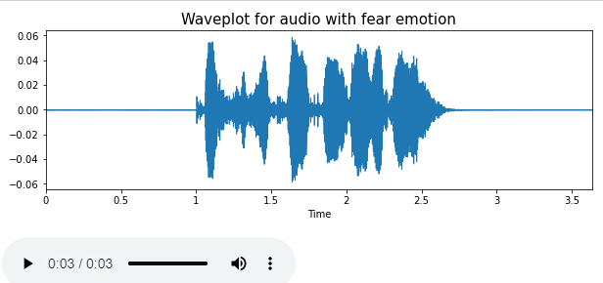
INPUT AND OUTPUT

Slide 17
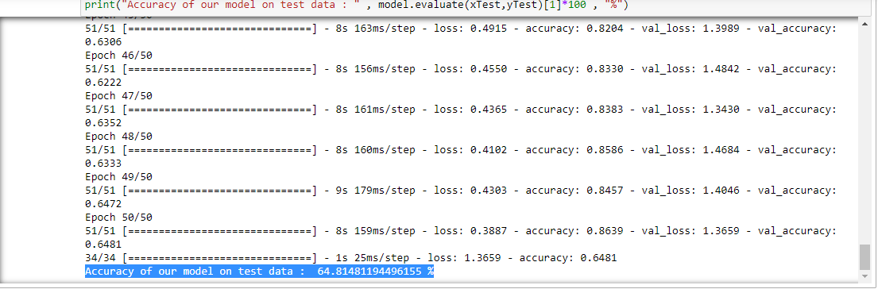
CONT…..

Slide 18
CONCLUSION
This project shows that MLPs are very powerful in classifying speech signals. Even with simplified models, a limited set of characters can be easily identified. We have obtained higher accuracies as compared to other approaches for individual emotions. The performance of a module is highly dependent on the quality of pre-processing. The results obtained in this study demonstrate that speech recognition is feasible, and that MLPs can be used for any task concerning recognizing of speech and demonstrating the accuracy of each emotion present in the speech.

Slide 19
REFERENCES
[1]Yang, Ningning, Dev Nilanjan, y Sherratt, R. Simon, Shi Fuqian. Recognize basic emotional statesin speech by machine learning techniques using melfrequency cepstral coefficient features. Journal of intelligent and fuzzy system, vol, 39 no, 2 pp.1925-1936, 2020.
[2]Navya Damodar, Vani H Y, Anusuya M A. Voice Emotion Recognition using CNN and Decision Tree. InternationalJournal of Innovative Technology and Exploring Engineering(IJITEE), October 2019
[3] Sarma, M., Ghahremani, P., Povey, D., Goel, N. K., Sarma, K. K., & Dehak, N. Emotion Identification from Raw Speech Signals Using DNNs. In Interspeech (pp. 3097-3101), 2018
[4] Brownlee, J. (2018). A Gentle Introduction to the Gradient Boosting Algorithm for Machine Learning - Machine Learning Mastery.Machine Learning Mastery.

Slide 20
[5] Guo, J., Lei, Z., Wan, J., Avots, E., Hajarolasvadi, N., Knyazev, B., & Escalera, S., Dominant and complementary emotion recognition from still images of faces. IEEE Access, vol. 6, pp. 26391-26403, 2018
[6] Jianfeng Zhao, Xia Mao, Lijiang Chen. Learning Deep features to Recognise Speech Emotion using Merged Deep CNN. IET Signal Process., 2018
[7] Ayush Kumar Shah ,Mansi Kattel,Araju Nepal. Cromah Feature Extraction using Fourier Transform. Chroma_Feature_ xtraction. January 2019

Slide 21
Web References
[1]Speech Emotion Recognition using Neural Network and MLP Classifier https://www.semanticscholar.org/paper/Speech-Emotion-Recognition-using-Neural-Network-and-Joy-Kannan/d355e304989e124bf306e7f1929513eeb69b3d61
[2] A machine learning model for emotion recognition from physiological signals
https://www.sciencedirect.com/science/article/abs/pii/S1746809419302277
[3] Automatic Audio Based Emotion Recognition System: Scope and Challenges https://papers.ssrn.com/sol3/papers.cfm?abstract_id=3565861
[4] InternationalJournal of Innovative Technology and Exploring Engineering https://ijesc.org/upload/17015f34daa6e925c92ce026adabfca9.Speech%20Emotion%20Recognition%20using%20Neural%20Network%20and%20MLP%20Classifier.pdf

Slide 22
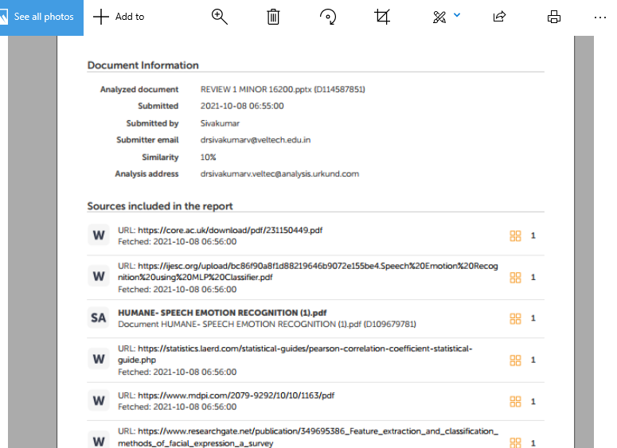
Plagiarism report

Slide 23
THANK YOU

